Slide 1
FLUBIO-PETSC Yet another CFD solver – In turbulent times –
Joel Guerrero
University of Genoa + Wolf Dynamics
Edoardo Alinovi
University of Genoa

Slide 2
FLUBIO-PETSC
FLUBIO-PETSC or FLUBIO for short, is an unstructured, parallel, finite-volume based Navier–Stokes and convection–diffusion like equations solver for teaching and research purposes.

Slide 3
What about the name of the solver? Why FLUBIO-PETSC?
Homage to our old research group FLUBIO at the University of Genoa.
The word FLUBIO is a portmanteau of the word FLUVIO (river in Italian) and the prefix BIO (as in biomimetics, biological, bioinspiration).
And it is FLUBIO-PETSC, because we leverage the high-performance library PETSC.

Slide 4
What is FLUBIO? – General description
FLUBIO is an unstructured, parallel, finite-volume method based solver.
FLUBIO can deal with 1D, 2D, and 3D domains.
FLUBIO is targeted to solve the Navier-Stokes equations and convection-diffusion like equations.
FLUBIO is written using modern Fortran (2003+ standard).
FLUBIO is object-oriented and allows for code re-use and code extensions.
FLUBIO comes with a collection of modules containing the numerical operations commonly found during the discretization of the governing equations using the Finite Volume Method (FVM).
FLUBIO uses a coding standard to promote clarity and understandability. It makes wide use of comments.
FLUBIO is targeted at students, academics, and practitioners willing to understand the general theory behind modern CFD solution methods and discretization techniques.
At the same time, FLUBIO is general and capable enough to deal with complex problems.
And most important, it is open-source.

Slide 5
What is NOT FLUBIO? – Disclaimer
First of all, it is under development by a very small group of two people (as of March 2021); therefore, do not expect rapid development times.
Many things are not present at the moment, but there is always a way around the problems. To name a few missing features:
Meshing capabilities.
Extended sampling capabilities.
Many monitors and on-the-fly post-processing.
Support to hanging nodes.
Support to post-process polyhedral cells.
FLUBIO is not bug-free.
It may not be the right tool for you.
It is not a silver bullet.

Slide 6
What is NOT FLUBIO? – Disclaimer
It is not a GUI-based solver; therefore, it has a steep learning curve.
But we have plans for a GUI and a cloud-based interface.
It is not a solver for the absolute beginner.
To start using FLUBIO, you need to be a little bit familiar with the FVM method.
You also need to have a minimal exposure to the Linux OS and JSON file format.
FLUBIO is not a high-level programming environment, at least for the moment.
Do not expect to start to do your own developments right ahead.
To start developing in FLUBIO, you need to have some FORTRAN working knowledge.
You will also need to get familiar with the API.
As a research-academic software, it is very experimental, it is not very stable.
But on the positive side, we have had the opportunity to experiment with many crazy concepts.

Slide 7
FLUBIO under the hood
Collocated (cell-centered) finite volume method solver.
It uses unstructured meshes.
It supports the following cell types:
Triangle and quad cells in 2D.
Tetrahedral, hexahedral, prismatic, and pyramid cells in 3D.
The governing equations can be discretized on a term-by-term basis.
Many discretization schemes available for the time derivative, gradient terms, diffusive terms and convective terms appearing in the governing equations.
It comes with many high-resolution methods.
Overall second-order accuracy in space and time.
To enforce the monotonicity principle, slope limiters are implemented.
Notes:
FLUBIO is a collection of modules mimicking the numerical operations to be carried out in a Finite Volume framework
So far it supports the following cell types: tetra, hexes, prisms, and pyramids.
Common operations implemented in module for easy re-use – move somewhere else

Slide 8
FLUBIO under the hood
Pressure-velocity coupling is achieved via segregated solvers using the following methods,
SIMPLE, SIMPLEC, PISO, fractional-step.
To avoid the checkerboard instability, the Rhie–Chow interpolation is used.
It is possible to save in ASCII format the matrices assembled during the discretization process.
Non-uniform boundary conditions, non-uniform initial conditions, and linear and non-linear source terms can be defined directly in the input files. No need for programming.
Parallelization via domain decomposition.
It leverages PETSC for the solution of the linear systems arising from the discretization of the equations.
The solution can be visualized using paraview or any visualization tool that supports unstructured VTK data.
Notes:
FLUBIO is a collection of modules mimicking the numerical operations to be carried out in a Finite Volume framework
So far it supports the following cell types: tetra, hexes, prisms, and pyramids.
Common operations implemented in module for easy re-use – move somewhere else

Slide 9
Motivation behind FLUBIO
There is a lot of literature addressing CFD and the FVM that is distributed with basic solvers for teaching purposes [1-7].
These solvers are getting old, do not make use of modern developments in CFD, are not supported anymore, do not support unstructured meshes, do not run in parallel, are not well documented, among many issues.
With FLUBIO, we aim to address the need of many students and researchers to have a code easy to understand and to modify, but at the same time uses modern CFD developments.
A solver that can be used to test hypotheses but still able to deal with complex geometries and industrial problems.
We want to address the frustrations and difficulties found when using legacy solvers and solvers lacking documentation.
We do not want to compete with well-established open-source CFD solvers. To name a few, OpenFOAM, SU2, code-saturne, MFIX, FEniCS, fluidity.
As an open-source project, everybody is welcome to join the development. There is a lot of room for new ideas, we are open minded and open to suggestions.
[1] The Finite Volume Method in Computational Fluid Dynamics: An Advanced Introduction With OpenFOAM and Matlab. F. Moukalled, L. Mangani, M. Darwish. 2015, Springer-Verlag
[2] Finite Volume Methods for Hyperbolic Problems. R. Leveque. 2002, Cambridge University Press.
[3] Computational Gasdynamics. C. Laney. 1998, Cambridge University Press.
[4] Computational Methods for Fluid Dynamics. J. H. Ferziger, M. Peric, R. Street. 2020, Springer.
[5] Computation of Conduction and Duct Flow Heat Transfer. S. Patankar. 1991, Innovative Research, Inc.
[6] Riemann Solvers and Numerical Methods for Fluid Dynamics: A Practical Introduction. E. Toro. 2009, Springer.
[7] Computational Fluid Dynamics. Vol. 1-2. K. Hoffmann, S. Chiang. 2000, EESbooks.
Notes:
Being a young and open source project, people will be able get involved in the development and be able to follow more closely what is going on in the pipeline

Slide 10
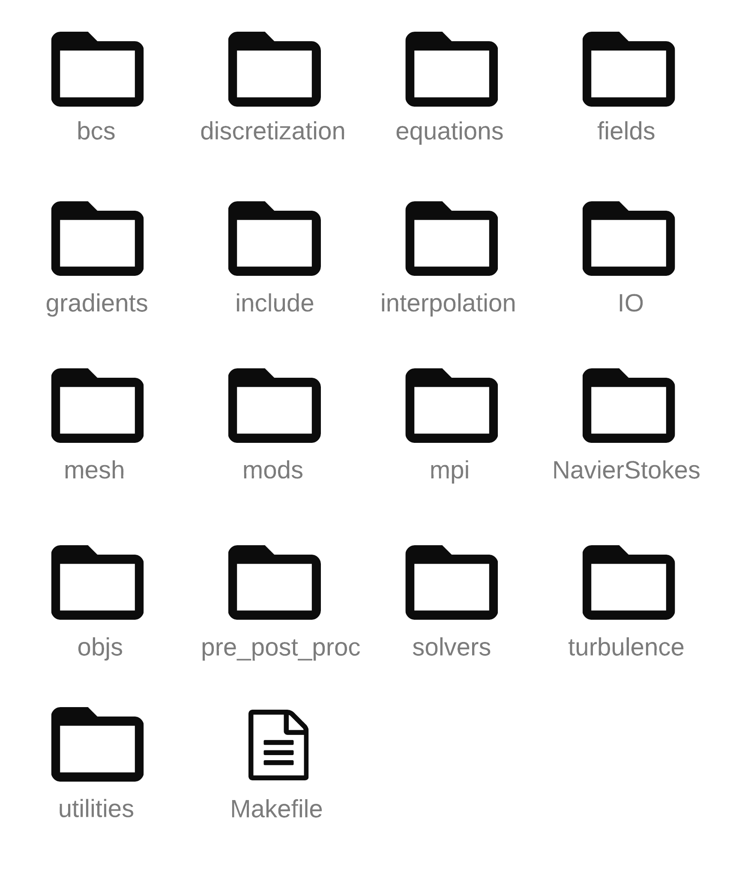
Source code organization
The source code is distributed into many directories.
Each directory containing a building block of the whole library.
The name of each directory is representative of a step in the FVM, the physics involved, or the data structure.
Inside each directory, you will find the source code, which has been commented to the best of our capability.
Additionally, you will find the documentation in FORD format.
The code is very compact, and it compiles fast.

Slide 11
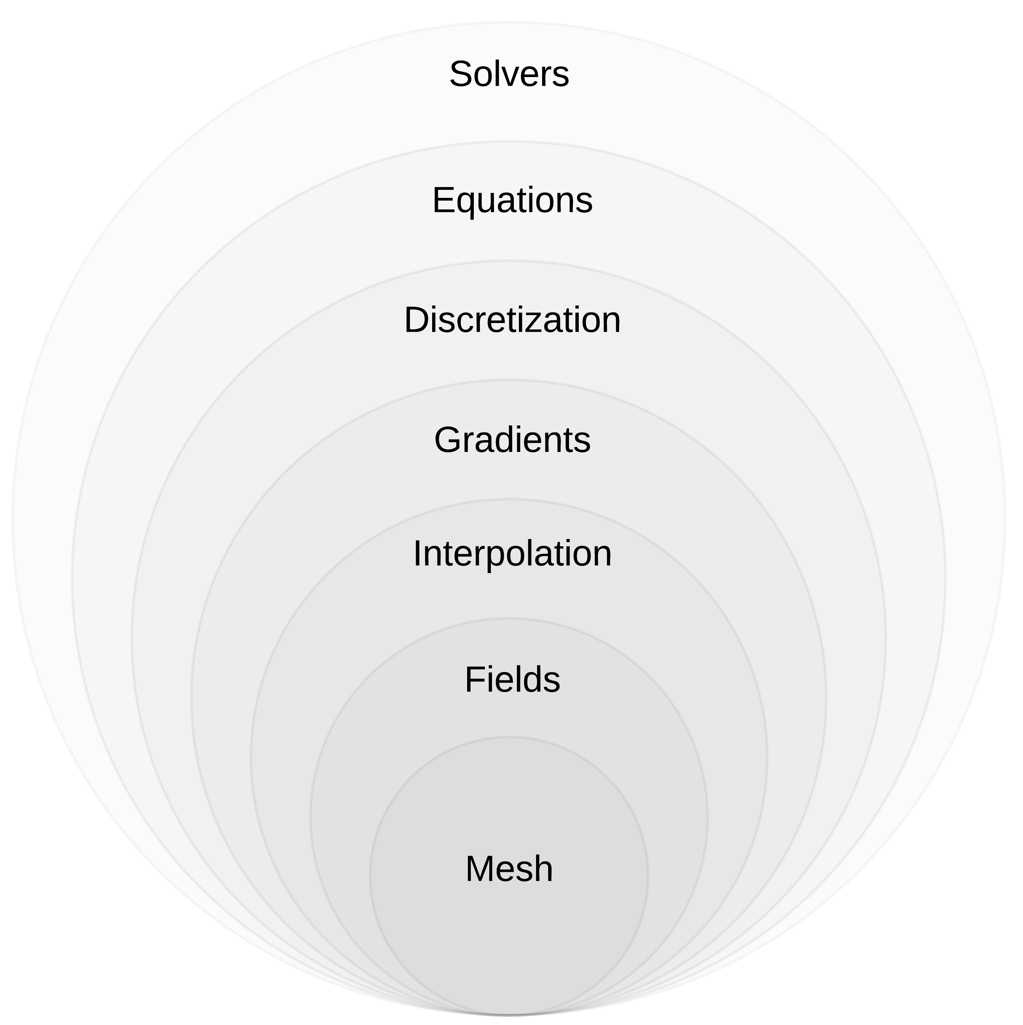
Building blocks
FLUBIO structure follows the steps used when discretizing the governing equations using the FVM.
FLUBIO objects are wrapped into different drivers to be used when implementing solvers.
The method and procedures used are compact and reusable.
FLUBIO is extensively commented and documented to the best of our capability.
Additions are straightforward with a good understanding of the API and FORTRAN.

Slide 12
Discretization options
The governing equations can be discretized on a term-by-term basis.
Different methods with different accuracy can be used.
Tailored discretization methods can be added by simply following the existing templates.
Term | Brief description
Gradient | Cell-based Green–Gauss and least-squares. To enforce monotonicity and improve solution stability, gradient limiters can be used. Face-limited and cell-limited versions are available.
Transient term | Methods for iterative and time marching. Methods implemented: Steady-state, Euler, Backward differencing, Crank–Nicolson.
Diffusion term | Weighted central differences with non-orthogonal corrections. Three methods available, namely, over-relaxed, orthogonal correction, and minimum correction.
Convective term | State of the art convective schemes applicable to unstructured meshes. Many methods implemented, to name a few, upwind, central differences, second-order upwind, QUICK, minmod, vanleer, superbee.

Slide 13
Solvers currently implemented
Solver name | Target equation | Brief description
flubio_poisson |  | Transient and steady solver for the Poisson equation
flubio_potential |  | Steady state potential flow solver
flubio_burgers |  | Transient solver for the viscous Burgers equation.
flubio_transport |  | Transient and steady state solver for the convection–diffusion equation
flubio_simple |  | Steady state, incompressible, Navier–Stokes solver using the SIMPLE algorithm
flubio_piso |  | Transient, incompressible, Navier–Stokes solver using the PISO algorithm
flubio_fs |  | Transient, incompressible, Navier–Stokes solver using the fractional step method by Teman & Chorin

Slide 14
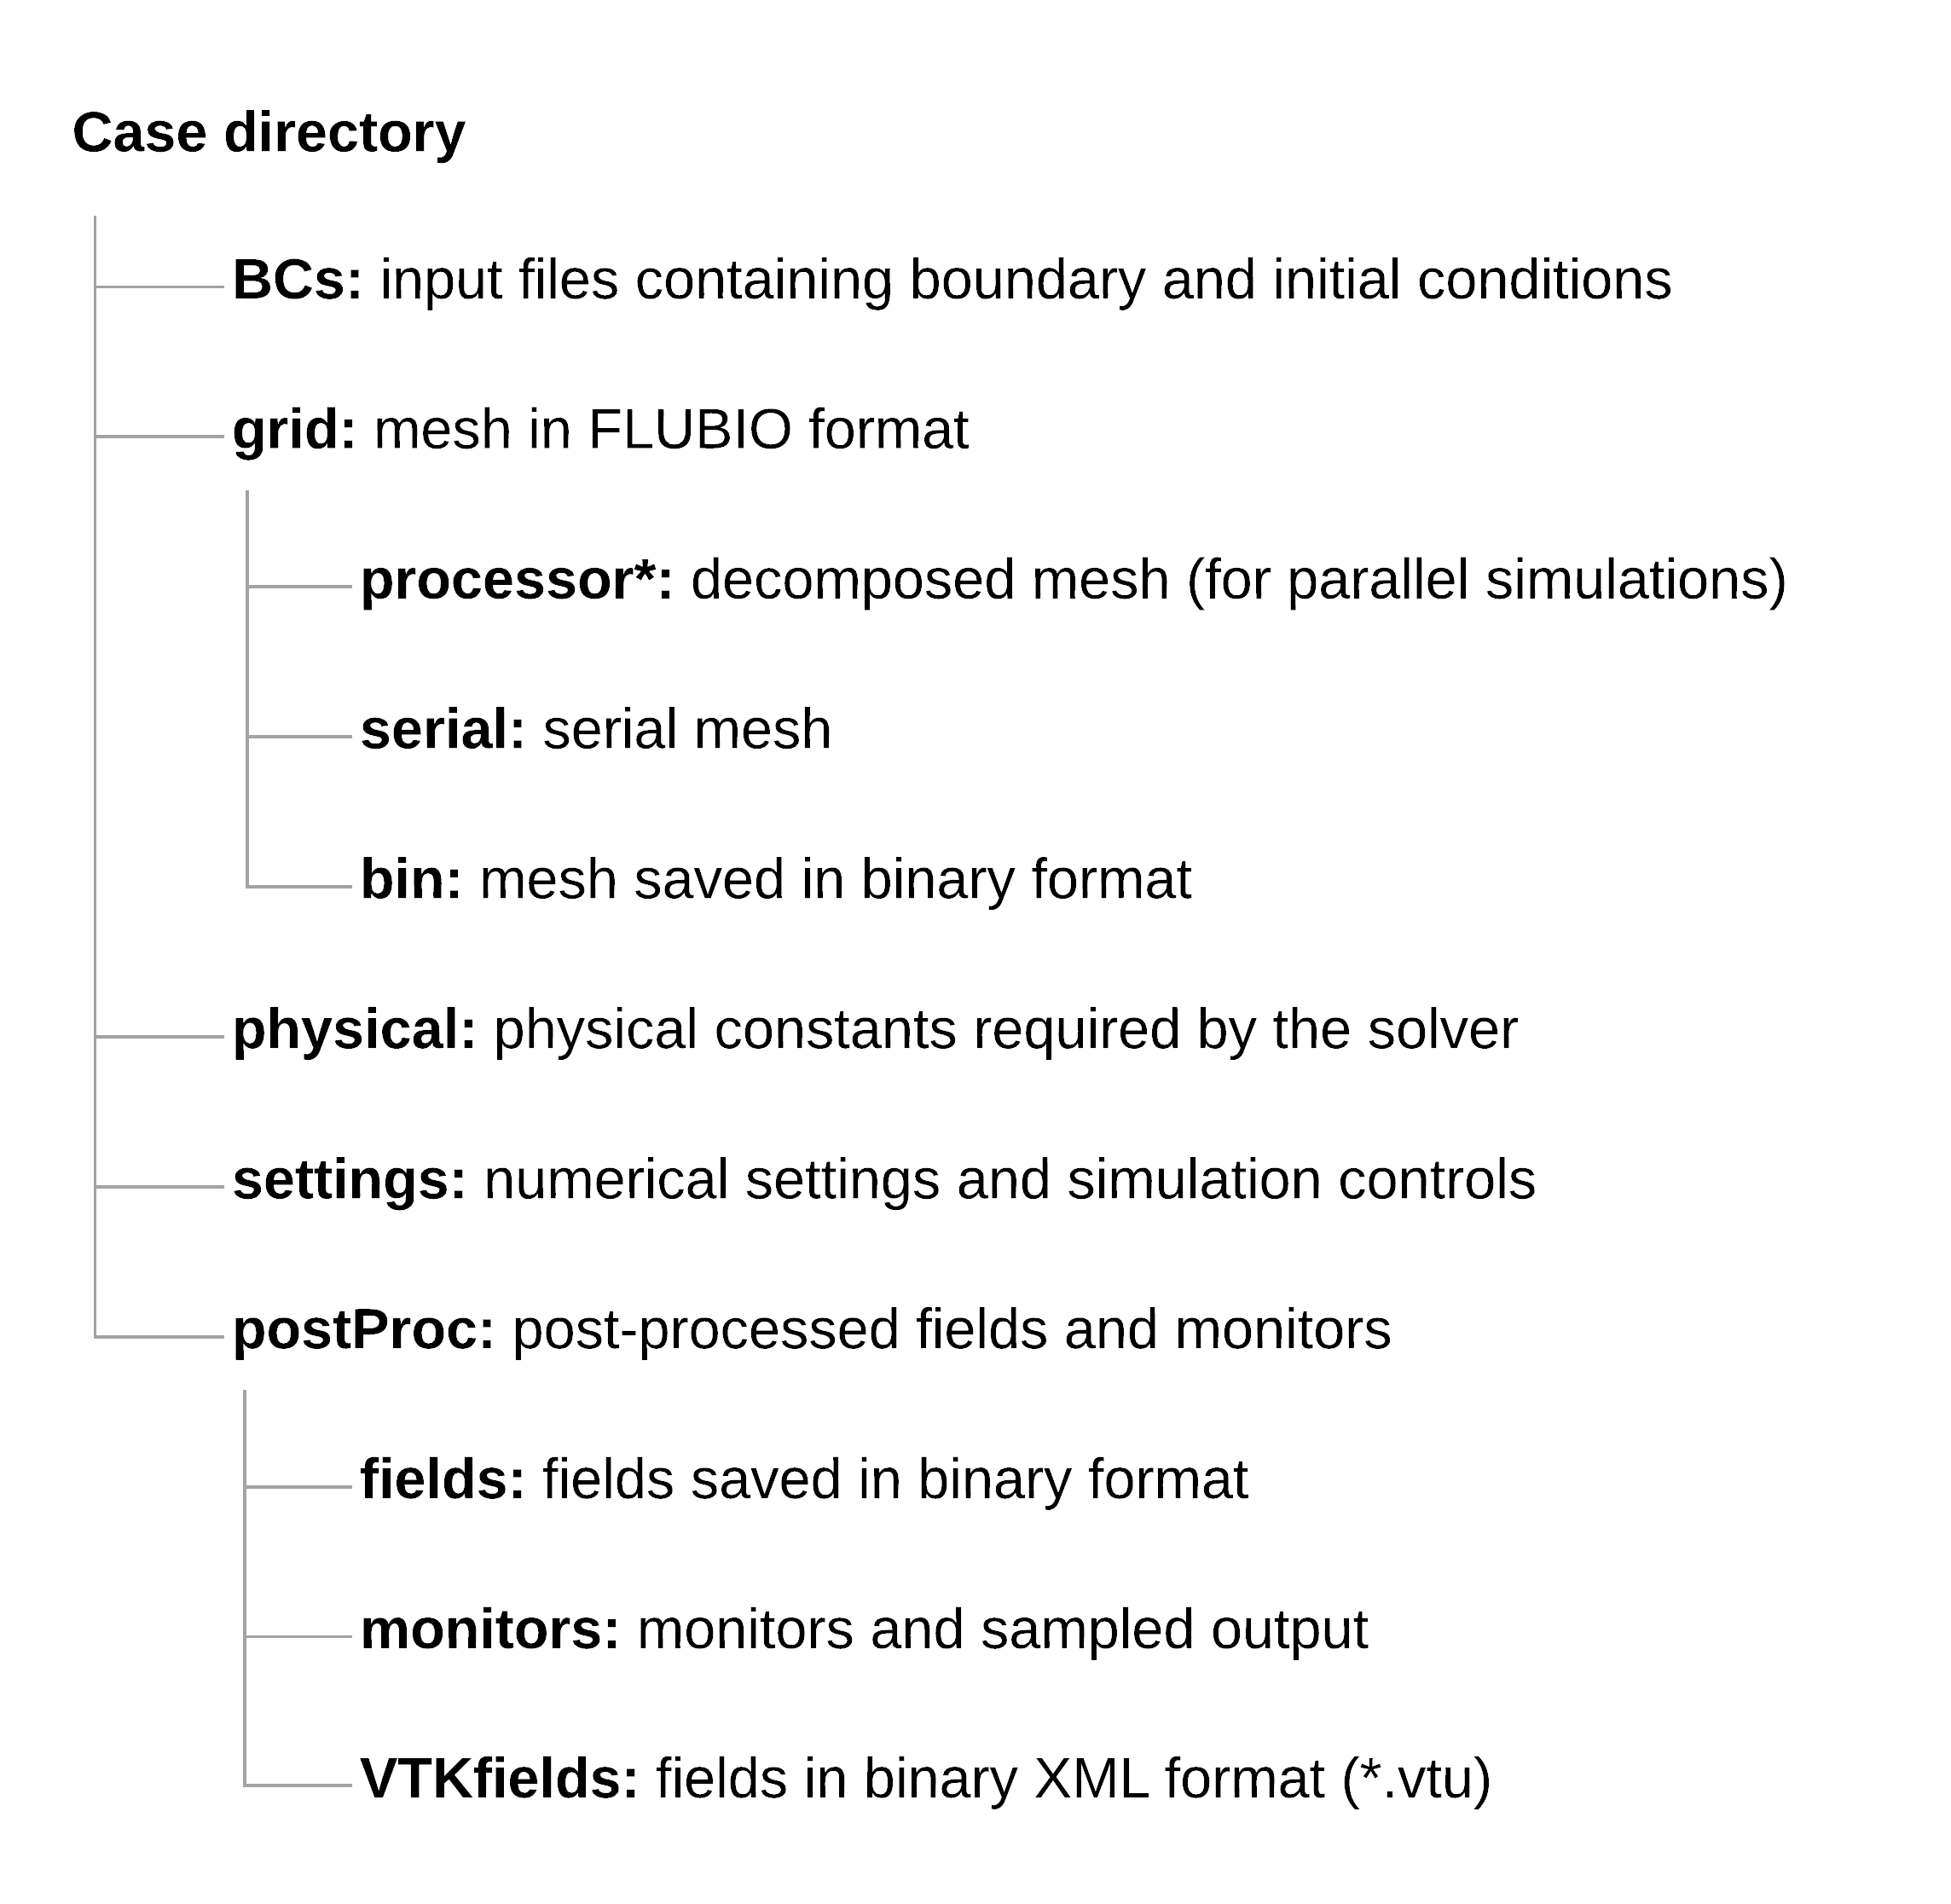
Case organization
In FLUBIO, cases are organized in stand-alone folders.
The user must respect the directory organization illustrated in the figure.
The input files are formatted using JSON format.

Slide 15
Input files – JSON format
Sample input files
The format of the input files is very flexible.
Input files are parsed and stored as JSON dictionaries.
There is no need to respect the order of the entries.
Only compulsory entries are required.
If you forget one compulsory entry or if you misspelled an entry, FLUBIO will let you know what and where the problem is, and in most situations, it will give you a list of options.
Unused keywords are allowed. They are ignored at parsing time.
Comments can be added by inserting the exclamation mark (!) at the beginning of the line.
Boundary conditions:
Controls:
“sides”:
{
“type”: “Dirichlet”,
“value”: [0]
),
“top”:
{
“type”: “userDefinedDirichlet”,
“value:: “sin(3.14159*x)”
},
“fb”:
{
“type”: “void”,
“value”: [0]
}
“internalField”: “0.0”
{
! Time step controls
“TimeStep”: 1.0,
“MaximumTime”: 1000,
! I/O controls
“FieldsToKeep”: 5,
“saveEvery”: 100,
“SaveGradients”: [“T”],
! Restart from
“RestartFrom”: -1
}
Notes:
Following JSON format, sub-dictionaries can be used to enhance the input or increase the complexity without compromising readability.

Slide 16
Turbulence modeling capabilities
The following RANS/URANS models are currently implemented:
Spallart-Almaras.
k-Omega Wilcox, k-Omega BSL, k-Omega SST.
y⁺ insensitive wall functions are implemented for k-Omega models.
The following LES models are currently implemented:
Smagorinsky.
WALE.
And, of course, the exact Navier-Stokes equations (DNS).
We are currently working hard on extending FLUBIO turbulence modeling capabilities.
We are also conducting an extensive validation campaign addressing the cases presented in the Nasa Turbulence Modeling site:
https://turbmodels.larc.nasa.gov/
Notes:
We are currently working hard on extending FLUBIO’s turbulence modeling capabilities.

Slide 17
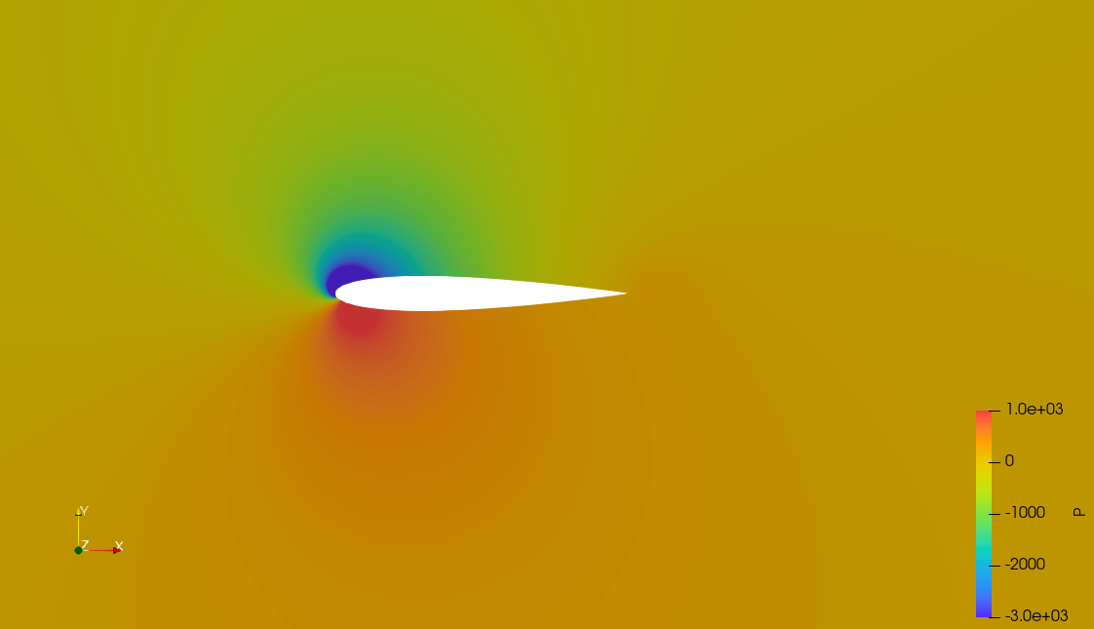
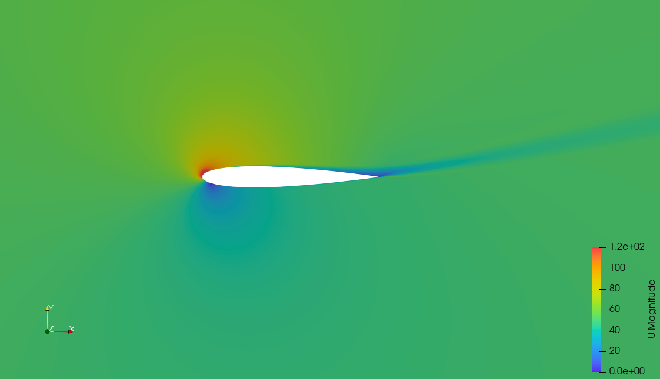
Some FLUBIO sugar
Turbulent flow past a NACA 0012 airfoil
Re = 6 000 000
Angle of attack = 0°, 10°, 15°,
RANS simulation using Spalart-Allmaras turbulence model.
Wall resolving.
Pressure contours (top) and velocity contours (bottom) at 15°
Term | Discretization method
Gradient terms | Green-Gauss node based with slope limiters
Convective terms | Second-order upwind
Diffusive terms | Centered differences – Over-relaxed corrections
Notes:
We are currently working hard on extending FLUBIO’s turbulence modeling capabilities.

Slide 18
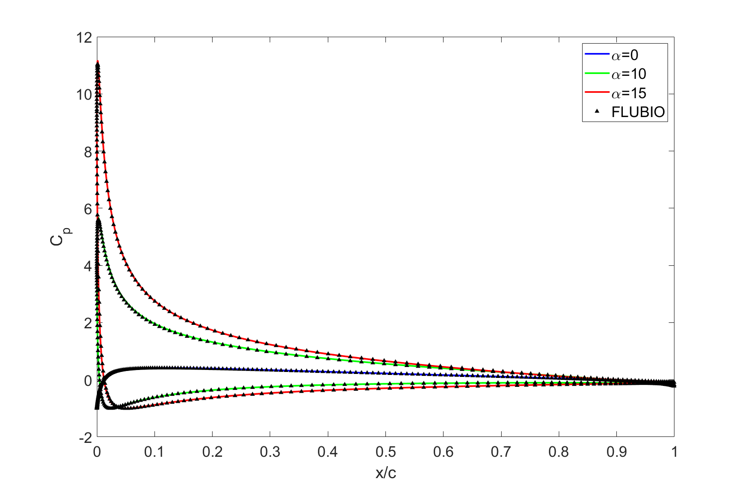
Some FLUBIO sugar
Turbulent flow past a NACA 0012 airfoil
Re = 6 000 000
Angle of attack = 0°, 10°, 15°,
RANS simulation using Spalart-Allmaras turbulence model.
Wall resolving.
 | 0° |  | 15°
Solver | C_{L} | C_{D} | C_{L} | C_{D}
FLUBIO | ≈ 0 | 0.00858 | 1.5527 | 0.02190
CFL3D | ≈ 0 | 0.00819 | 1.5461 | 0.02124
FUN3D | ≈ 0 | 0.00812 | 1.5547 | 0.02159
SUMB | ≈ 0 | 0.00813 | 1.5446 | 0.02141
Term | Discretization method
Gradient terms | Green-Gauss node based with slope limiters
Convective terms | Second-order upwind
Diffusive terms | Centered differences – Over-relaxed corrections
Pressure coefficient (CP) distribution – FLUBIO against CFL3D
Notes:
We are currently working hard on extending FLUBIO’s turbulence modeling capabilities.

Slide 19
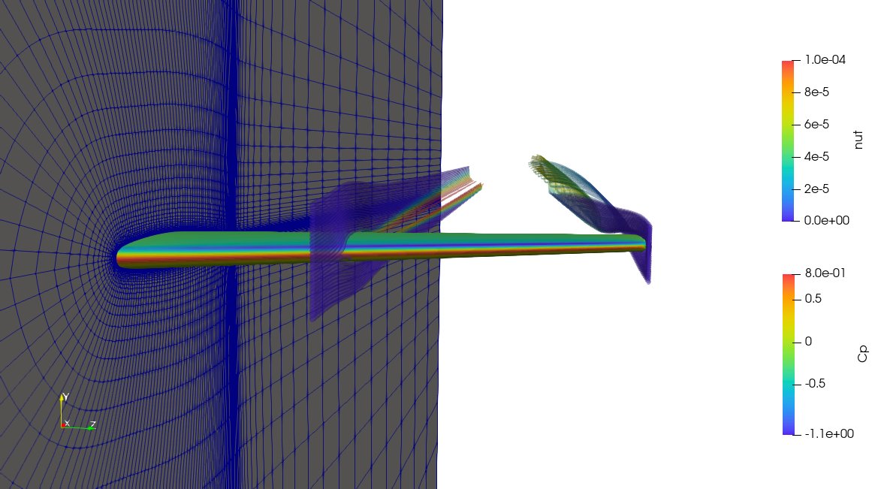
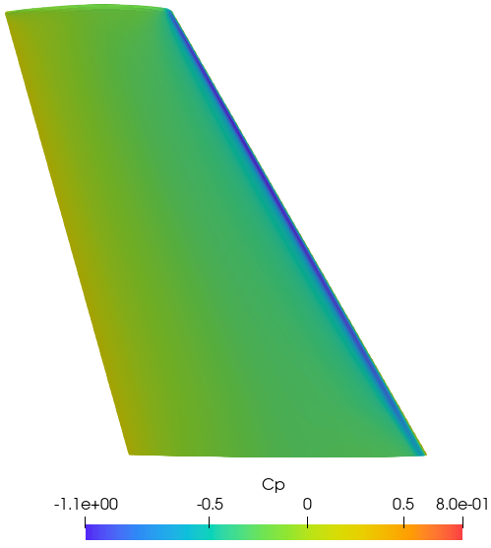
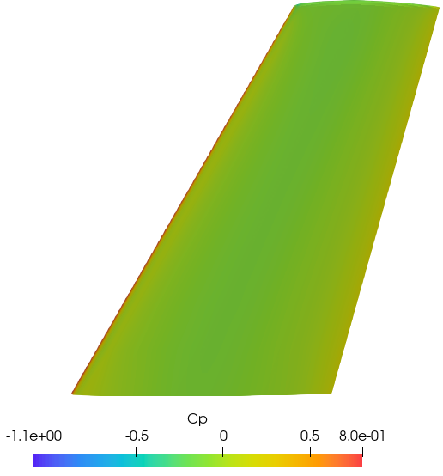
Some FLUBIO sugar
Turbulent flow past ONERA-M6 wing
Re = 1 000 000
Angle of attack = 3.06°
RANS simulation using Spalart-Allmaras turbulence model.
Wall resolving.
Term | Discretization method
Gradient terms | Green-Gauss node based with slope limiters
Convective terms | Second-order upwind
Diffusive terms | Centered differences – Over-relaxed corrections
Notes:
We are currently working hard on extending FLUBIO’s turbulence modeling capabilities.

Slide 20
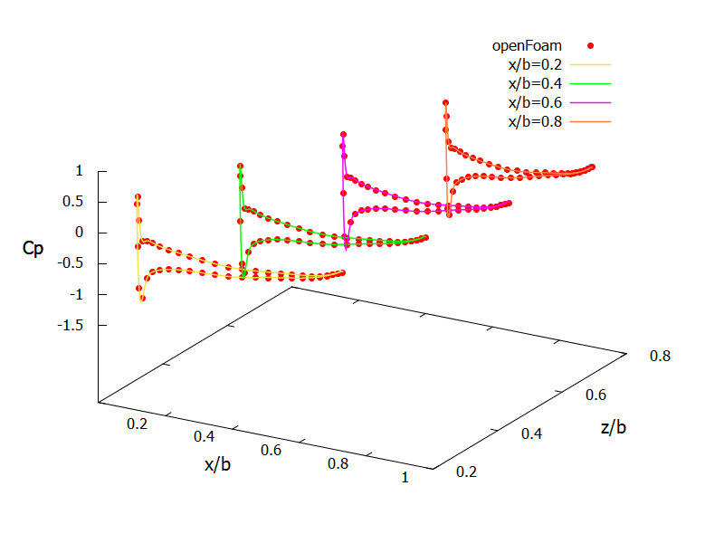
Some FLUBIO sugar
Turbulent flow past ONERA-M6 wing
Re = 1 000 000
Angle of attack = 3.06°
RANS simulation using Spalart-Allmaras turbulence model.
Wall resolving.
Solver | C_{D} | C_{L}
FLUBIO | 0.0067 | 0.0865
OpenFOAM | 0.0071 | 0.0847
Ansys Fluent | 0.0066 | 0.0866
Term | Discretization method
Gradient terms | Green-Gauss node based with slope limiters
Convective terms | Second-order upwind
Diffusive terms | Centered differences – Over-relaxed corrections
Pressure coefficient (CP) distribution at different locations
Notes:
We are currently working hard on extending FLUBIO’s turbulence modeling capabilities.

Slide 21
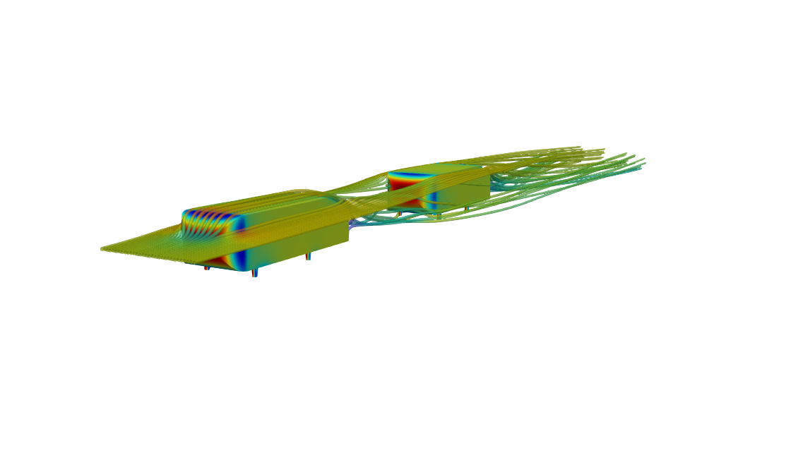
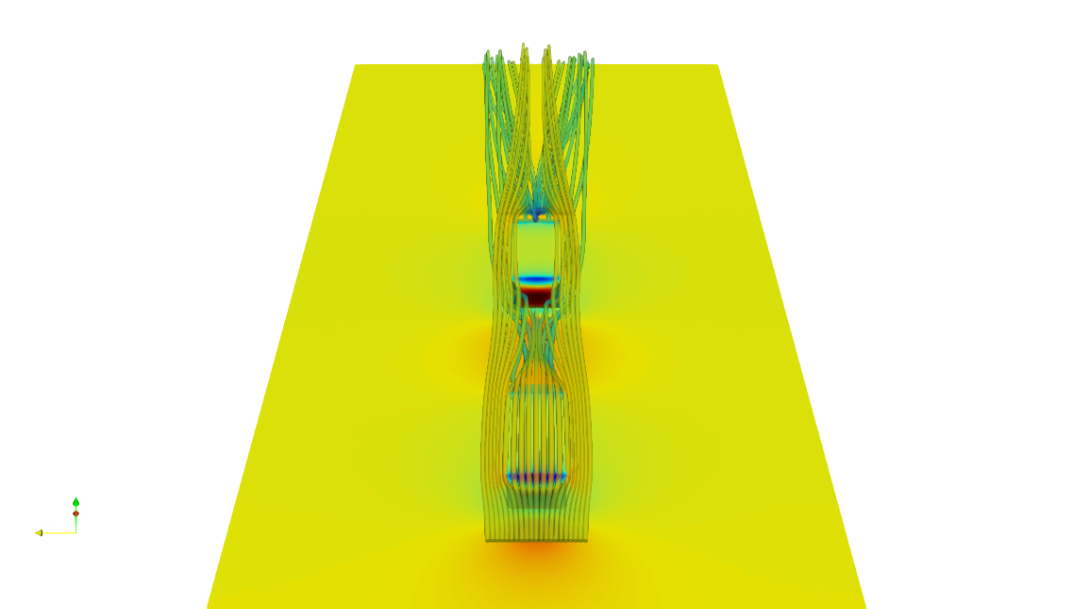
Some FLUBIO sugar
Two ahmed bodies in platoon formation
Inlet velocity = 10 m/s
Slant angle = 25°
RANS simulation using Spalart-Allmaras turbulence model.
Wall resolving.
Term | Discretization method
Gradient terms | Green-Gauss node based with slope limiters
Convective terms | Second-order upwind
Diffusive terms | Centered differences – Over-relaxed corrections
Notes:
We are currently working hard on extending FLUBIO’s turbulence modeling capabilities.

Slide 22
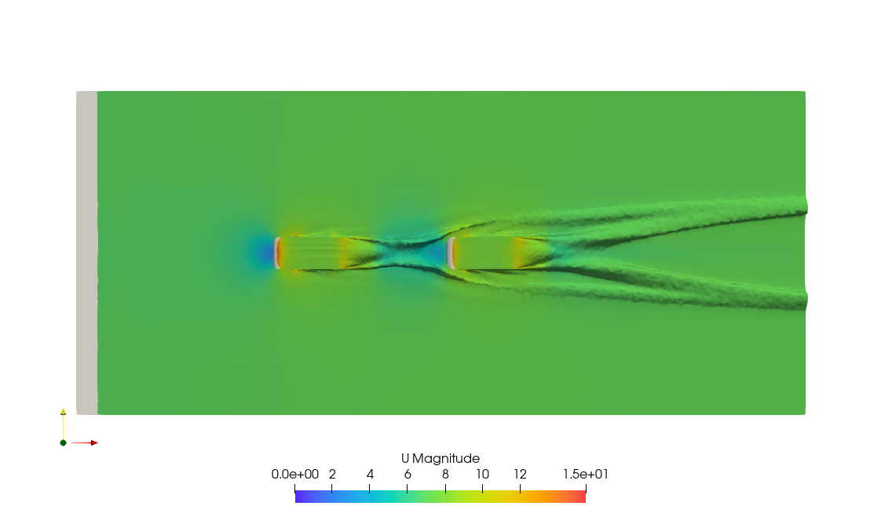
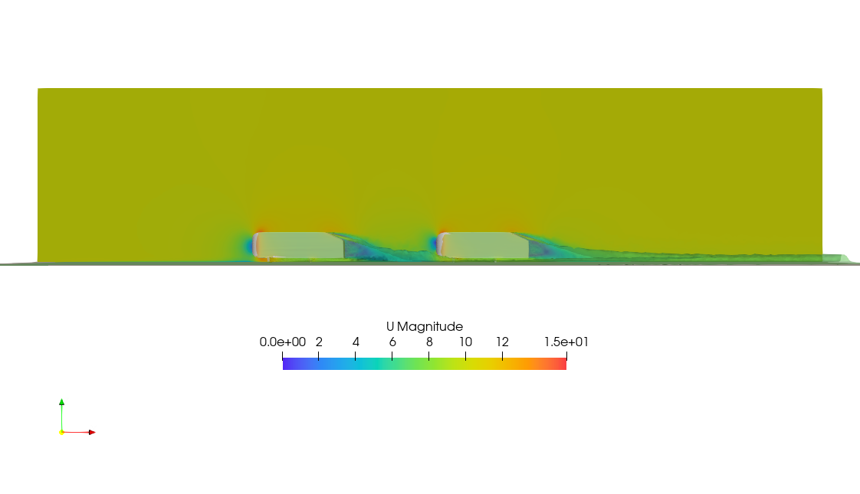
Some FLUBIO sugar
Two ahmed bodies in platoon formation
Inlet velocity = 10 m/s
Slant angle = 25°
RANS simulation using Spalart-Allmaras turbulence model.
Wall resolving.
Term | Discretization method
Gradient terms | Green-Gauss node based with slope limiters
Convective terms | Second-order upwind
Diffusive terms | Centered differences – Over-relaxed corrections
Notes:
We are currently working hard on extending FLUBIO’s turbulence modeling capabilities.

Slide 23
What is next?
Short term goals,
Detailed validation campaign of the solvers implemented so far.
More on turbulence modeling.
Code profiling and code performance assessment.
Improvement of post-processing capabilities.
Removing some dependencies with OpenFOAM.
For the moment only meshing.
We just removed the mesh decomposition dependency.
More on documentation.
More video tutorials.

Slide 24
What is next?
Long term plans (very ambitious),
Pressure-based solvers for compressible flows.
Coupled pressure-based solvers.
VOF solvers (volume of fluid).
Immersed boundary methods (direct forcing) for moving and elastic bodies.
Conjugate heat transfer capabilities.
Support for CGNS format.
Exascale computing leveraging PETSC-HYPRE.

Slide 25
Help is needed and much appreciated
FLUBIO is under constant development by a very small but dedicated group.
To reach the previous goals, we need your support.
Everybody is welcome to contribute, and we are open to any collaboration.
Also, we highly encourage you to break the solver. Do not forget to report the issue.
If you want to help us in improving FLUBIO or you are interested in joining the development team, please send an email to flubiopetsc@gmail.com.

Slide 26
Where can I get FLUBIO?
You can get the source code at the following link,
https://gitlab.com/alie89/flubio-code-fvm
If you break the solver or find bugs, please report the issue using the issue tracker on the project's GitLab repository.

Slide 27
Where can I get more information?
To find more information, visit FLUBIO website,
https://flubiopetsc.github.io/flubiopetsc/
To get started with FLUBIO and to get further information about how to use the solver; we invite you to read the tutorial manual, which comes with the source code and is located in the examples directory.
You can also follow the link Getting started with FLUBIO. At this link, you will find many video tutorials.
https://flubiopetsc.github.io/flubiopetsc/getting_started.html

Slide 28
How to cite FLUBIO?
E. Alinovi, J. Guerrero, “FLUBIO – An unstructured, parallel, finite-volume based Navier-Stokes and convection-diffusion like equations solver for teaching and research purposes,” SoftwareX, Volume 13, January 2021, 100655. https://doi.org/10.1016/j.softx.2020.100655
Permanent link to the publication (open access)
https://www.sciencedirect.com/science/article/pii/S235271102030368X

Slide 29
Live demonstration

